Slide 1
PVRV Calibration Training

Slide 2
Abbreviations
Definitions
Design Overview
Functionality Overview
Calibration Process

Slide 3

Abbreviations
PVRV - Pressure Vacuum Relief Valve
ADJ SCREW-Adjusting screw for pressure setting
P.R SPRING- Pressure Relief Spring
V.R SPRING- Vacuum Relief Spring
V1- Pressure Gauge Isolation Valve
V2- Vacuum Inlet Isolation Valve
V3- Vacuum Gauge Isolation Valve
V4- Pressure Inlet Isolation Valve

Slide 4
Definitions
What is calibration?
Calibration is the comparison of measured value delivered by a device under test with those of a calibration standard of known accuracy
Or
the set of operations which establishes, under specified conditions, the relationship between the values of pressure indicated by a pressure gauge and the corresponding values of pressure realized by a reference standard
OIML -R

Slide 5
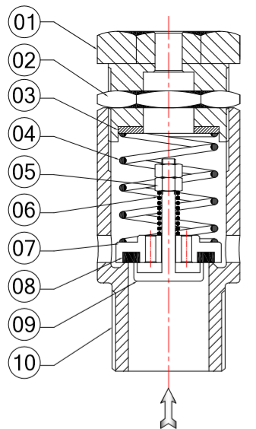
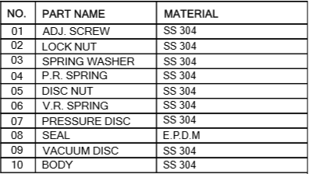
PVRV Design Overview

Slide 6
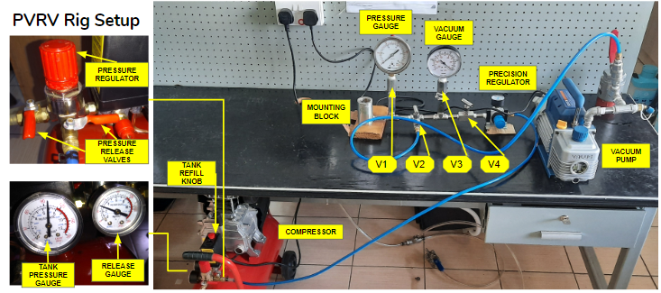
Calibration Rig Design Overview
Parts Overview
V1- Pressure gauge isolation valve
V2- Vacuum pump isolation valve
V3- Vacuum gauge isolation valve
V4- Compressor isolation valve
Compressor
Has a gauge for its tank pressure and its pressure release rate. This rate can be regulated using the pressure regulator and then released using manual valve.
Vacuum Pump
Creates a vacuum in the system when the vacuum pump exhaust is covered with a finger for approximately 5-7 seconds.

Slide 7
PVRV Functionality Overview
Pressure/vacuum relief valve is a mechanical device used to regulate pressure in an enclosed system.
It’s pressure and vacuum settings are set/varied based on the hardness of a compressed springs at different heights.
The KP tank is an atmospheric tank hence always needs to be balanced out by pressure outside:
The PVRV therefore releases pressure when the tank pressure gets above 1.03bar to avoid the tank bulging and bursting under extreme internal pressures.
The PVRV also allows atmospheric pressure into the tank when it’s internal pressure drops to -0.01 bar to avoid the tank caving in and getting crushed due to the imbalance.

Slide 8
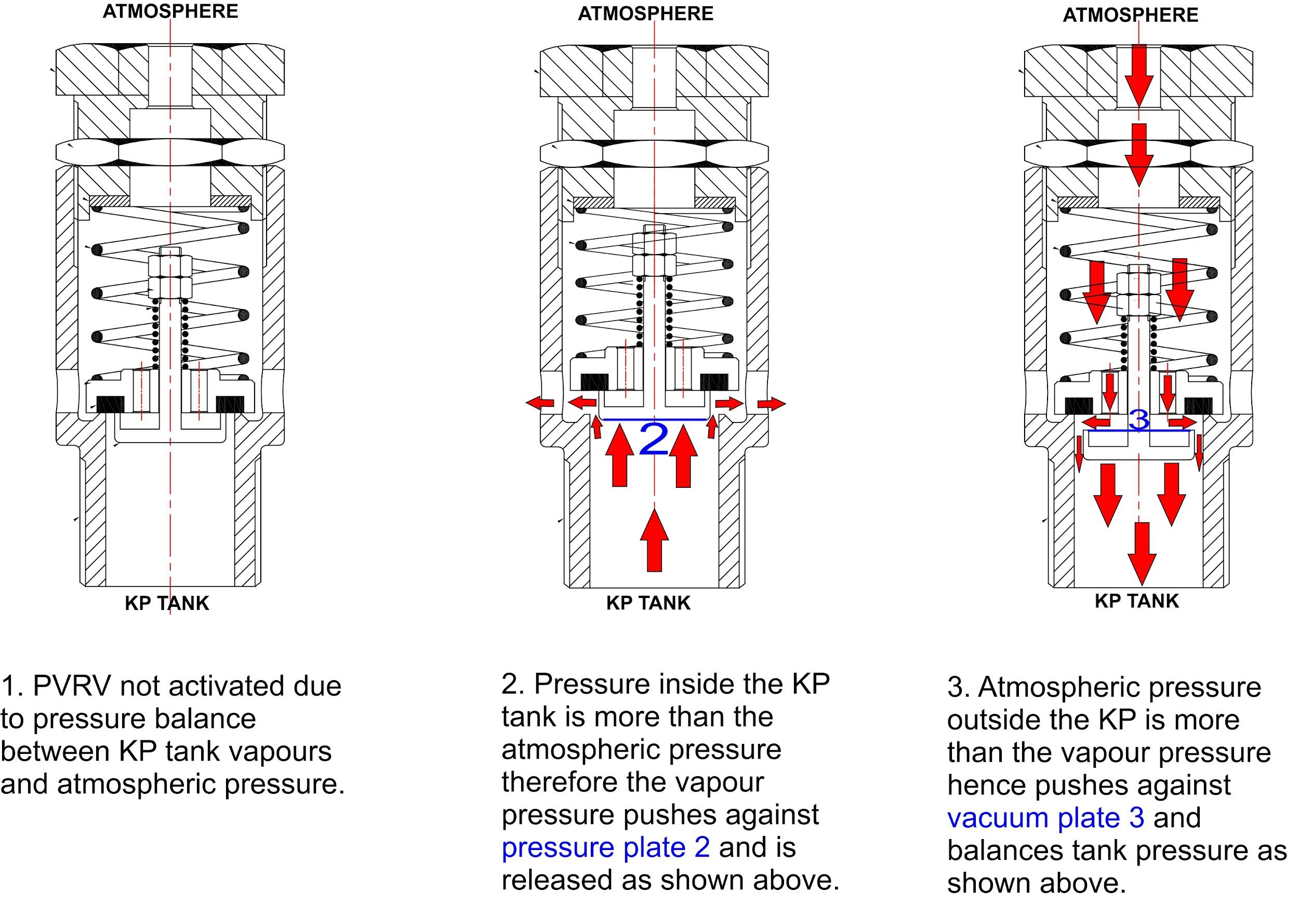
PVRV Functionality Overview

Slide 9
Calibration Rig Functionality Overview
The calibration rig is designed to provide measured, accurate and varying amounts of both pressure and vacuum using the compressor and vacuum pumps respectively.
The pressure gauge and vacuum gauge give accurate readings of the required values of 1.03 bar and -0.01 bar respectively.
The manual valves isolate the vacuum and pressure aspects of the rig during their separate calibration processes.

Slide 10
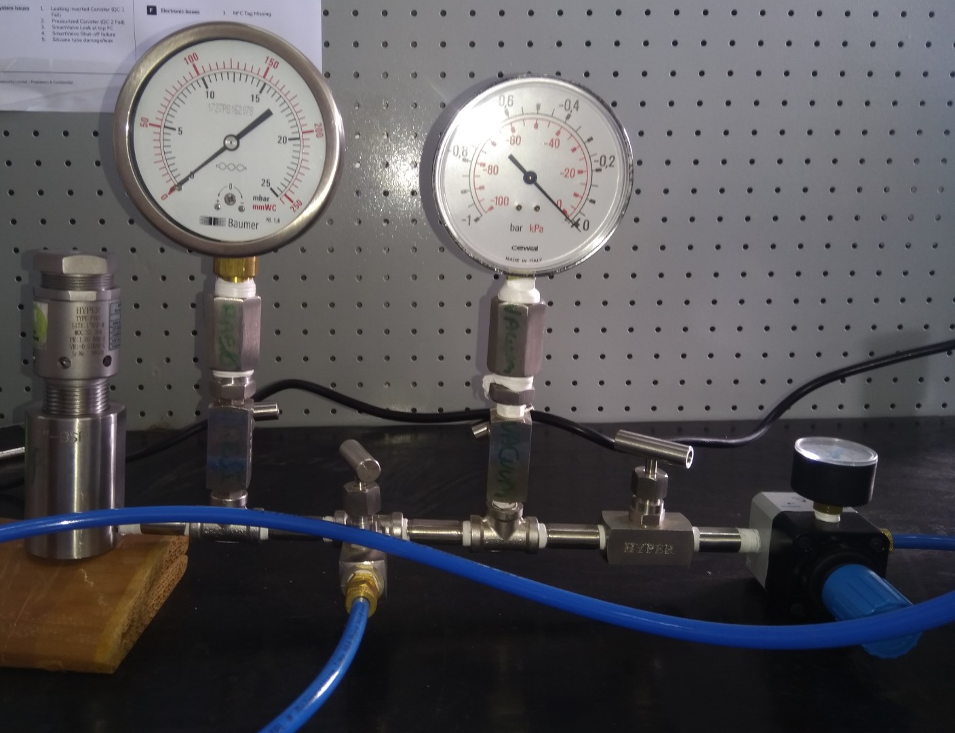
Calibration Rig Functionality: Vacuum Calibration
The pressure components of the rig are closed off while the vacuum components remain open when calibrating the PVRV vacuum value at -0.01 bar and 1KPa on the vacuum gauge
CLOSED
Vacuum Gauge
OPEN
OPEN
To vacuum pump
CLOSED

Slide 11
Calibration Rig Functionality: Pressure Calibration
The vacuum components of the rig are closed off while the pressure components remain open when calibrating the PVRV pressure value at 1.03 bar and 170mmWC on the pressure gauge.
Pressure Gauge
CLOSED
OPEN
OPEN
To compressor
CLOSED

Slide 12
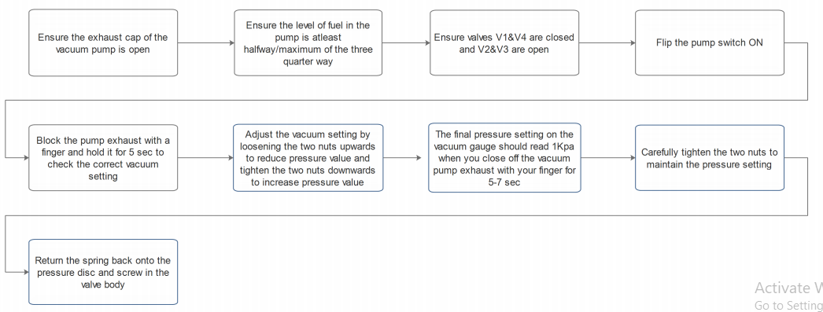
Calibration Process- Vacuum calibration
KNK OPS WI/T3 084

Slide 13
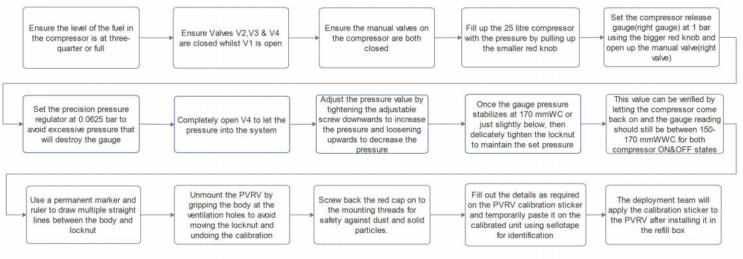
Calibration Process- Pressure calibration
KNK OPS WI/T3 084

Slide 14
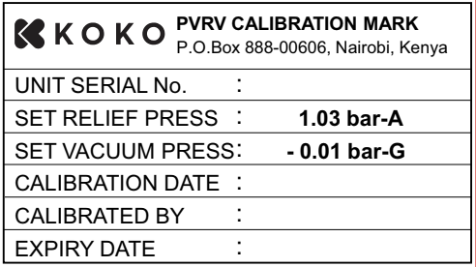
Calibration Process
After completing calibration the PVRV is labelled with a sticker is used indicating:
The unit serial number
Calibration date
Who calibrated the PVRV?
Expiry date
Also fill out the PVRV calibration report

Slide 15

Thank you

